Slide 1
Security Hardening – Case Study – AD
Active Directory Domain
DISA, Release 8
27 January, 2017

Slide 2
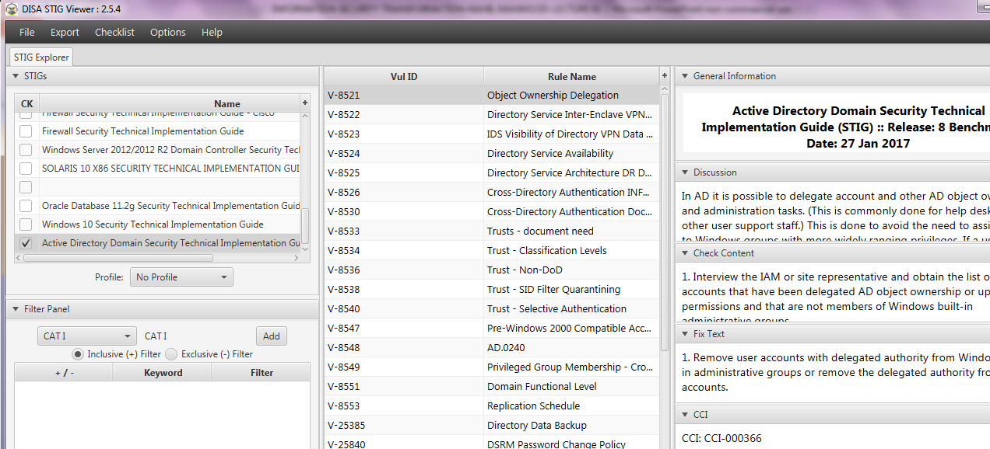
Security Hardening – Case Study – AD
STIGVIEWER WINDOW

Slide 3
Security Hardening – Case Study – AD
General Information:
Rule Title : Membership to the Domain Admins group must be restricted to accounts used only to manage the Active Dir domain and domain controllers

Slide 4
Security Hardening – Case Study – AD
General Information:
STIG ID: AD.0002
Severity: CAT I

Slide 5
Security Hardening – Case Study – AD
Discussion:
The Domain Admins group is a highly privileged group. Personnel who are system administrators must log on to Active Directory systems only using accounts with the level of authority necessary.

Slide 6
Security Hardening – Case Study – AD
Discussion:
…Only system administrator accounts used exclusively to manage an Active Directory domain and domain controllers may be members of the Domain Admins group. A separation of administrator…

Slide 7
Security Hardening – Case Study – AD
Discussion:
…responsibilities helps mitigate the risk of privilege escalation resulting from credential theft attacks.

Slide 8
Security Hardening – Case Study – AD
Check Content:
Review the Domain Admins group in Active Directory Users and Computers. Each Domain Administrator must have a separate unique account specifically for…

Slide 9
Security Hardening – Case Study – AD
…Check Content:
…managing the Active Directory domain and domain controllers.
If any account listed in the Domain Admins group is a member of other administrator groups including the

Slide 10
Security Hardening – Case Study – AD
…Check Content:
…Enterprise Admins group, domain member server administrators groups, or domain workstation administrators groups, this is a finding.

Slide 11
Security Hardening – Case Study – AD
Fix Text:
Create the necessary documentation that identifies the members of the Domain Admins group. Ensure that each member has a separate unique account that can only be used to manage the Active Directory...

Slide 12
Security Hardening – Case Study – AD
Fix Text:
…domain and domain controllers. Remove any Domain Admin accounts from other administrator groups.

Slide 13
Security Hardening – Case Study – AD
CCI (Control Correlation Identifier):
CCI-000366 The organization implements the security configuration settings. NIST SP 800-53 :: CM-6 b NIST SP 800-53A :: CM-6.1 (iv) NIST SP 800-53 Revision 4 :: CM-6 b
END

